Slide 1

INSTITUTE - UIE
DEPARTMENT- ACADEMIC UNIT-2
Bachelor of Engineering (Computer Science & Engineering)
Subject Name: Introduction to Problem Solving
Code:22CSH-101
Nested Loops
DISCOVER . LEARN . EMPOWER

Slide 2


Introduction to Problem Solving
Course Objectives
The course aims to provide exposure to problem-solving through programming.
The course aims to raise the programming skills of students via logic building capability.
With knowledge of C programming language, students would be able to model real world problems.

Slide 3



CO Number | Course Outcome
CO1 | Remember the concepts related to fundamentals of C language, draw flowcharts and write algorithm/pseudocode.
CO2 | Understand the way of execution and debug programs in C language.
CO3 | Apply various constructs, loops, functions to solve mathematical and scientific problem.
CO4 | Analyze the dynamic behavior of memory by the use of pointers.
CO5 | Design and develop modular programs for real world problems using control structure and selection structure.

Slide 4
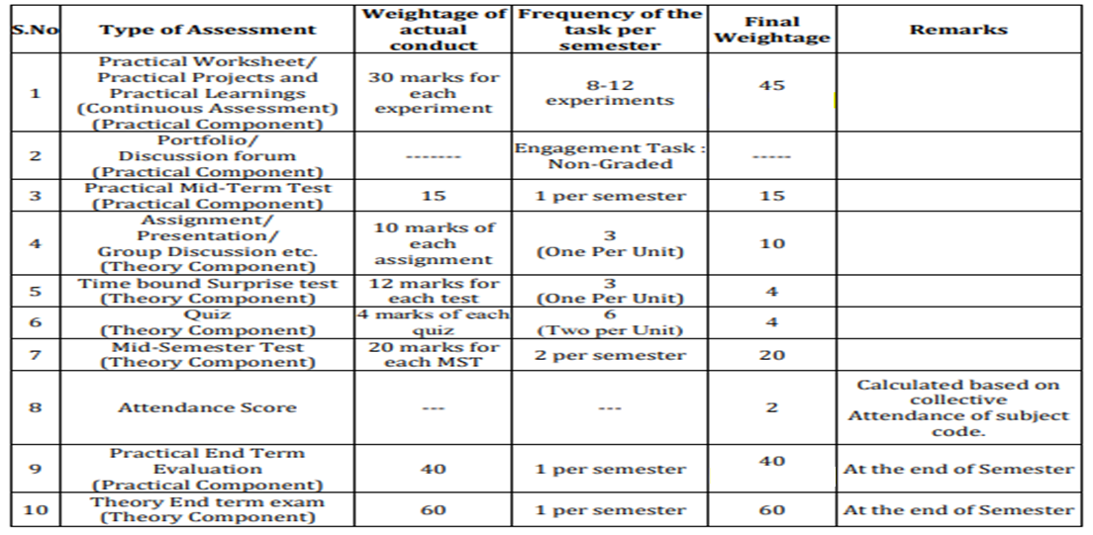
Scheme of Evaluation

Slide 5
Contents
Nested Looping
Syntax
Working
Examples

Slide 6
Nested Looping
I/O Statements
A loop within another loop is called nested loop. C programming language supports nesting of one loop inside another. We can define any number of loops inside another loop. And also have any number of nesting level..
Put any type of loop in another type. Write for loop inside while loop, while inside another while etc. A programmer nest up to 3 loops. But there is no limit of nesting in C.

Slide 7
Loops Definition & Syntax
Syntax
outer_loop { inner_loop { // Inner loop statement/s } // Outer loop statement/s }

Slide 8
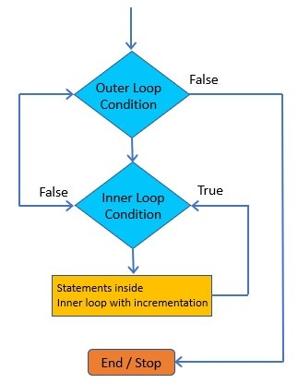
How Nested loop work:
There are two conditions that are given.
The inner loop condition gets executed only when the outer loop condition gives the Boolean output as True. Else the flow control directly goes out of both the loops.
Now coming into the execution of the inner loop, If the loop condition gives a true result, then the block of statements under that loop and the incremental condition gets executed.
And in turn, if the condition gives a Boolean condition as False, then the inner loop gives its control back to the outer loop and again same conditions/loops gets executed/repeated.

Slide 9
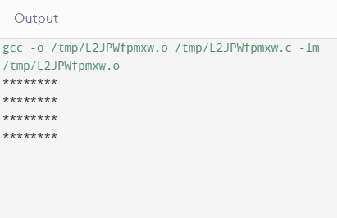
Example1 of Nested do-while loop
Explanation:
First, we initialize the outer loop counter variable, i.e., 'i' by 1.
As we know that the do..while loop executes once without checking the condition, so the inner loop is executed without checking the condition in the outer loop.
After the execution of the inner loop, the control moves to the update of the i++.
When the loop counter value is incremented, the condition is checked. If the condition in the outer loop is true, then the inner loop is executed.
This process will continue until the condition in the outer loop is true
#include <stdio.h>
int main()
{
int i=1;
do // outer loop
{
int j=1;
do // inner loop
{
printf("*");
j++;
}while(j<=8);
printf("\n");
i++;
}while(i<=4);
}
Output:

Slide 10
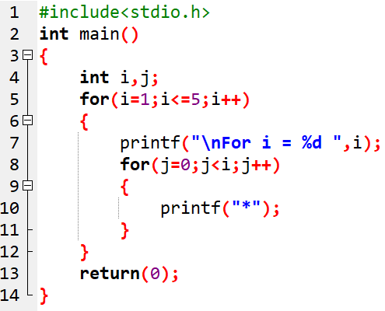
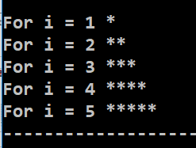
Example2 using Nested for loop
Output

Slide 11
Summary
A loop within another loop is called nested loop. C programming language supports nesting of one loop inside another.
We can define any number of loops inside another loop. And also have any number of nesting level.
Nested Looping
Write for loop inside while loop, while inside another while etc. A programmer nest up to 3 loops. But there is no limit of nesting in C.
It always executes the code block at least once and furthermore as long as the condition remains true.

Slide 12
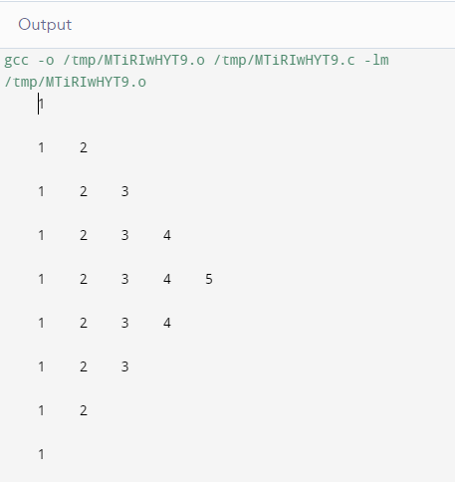
FAQ
Q1 Print the pattern
#include<stdio.h>
int main()
{
int i,j;
for(j=1;j<=5;j++)
{
for(i=1;i<=j;i++)
printf("%5d",i);
printf("\n\n");
}
for(j=4;j>=1;j--)
{
for(i=1;i<=j;i++)
printf("%5d",i);
printf("\n\n");
}
return 0;
}

Slide 13
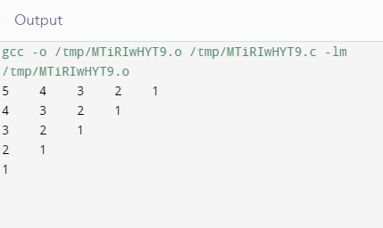
FAQ
Q2 Print the reverse pattern
#include<stdio.h>
int main()
{
int i,j;
for(j=5;j>=1;j--)
{
for(i=j;i>=1;i--)
printf("%5d",i);
printf("\n\n");
}
return 0;
}

Slide 14
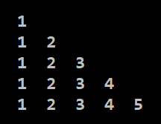
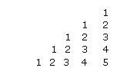
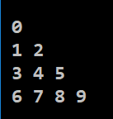
Assessment questions
Print the above two numbering patterns

Slide 15
References
Book References: http://www2.cs.uregina.ca/~hilder/cs833/Other%20Reference%20Materials/The%20C%20Programming%20Language.pdf
http://www.freebookcentre.net/programming-books-download/The-Basics-of-C-Programming.html
Vedio Lecture: https://study.com/academy/lesson/nesting-loops-statements-in-c-programming.html
https://www.youtube.com/watch?v=mZqo8KDR37U
https://nptel.ac.in/courses/106/104/106104128/
Websites: https://www.studytonight.com/c/programs/loop/nested-loops
https://beginnersbook.com/2014/01/c-for-loop/
https://www.tutorialspoint.com/cprogramming/c_nested_loops.htm

Slide 16
THANK YOU

